Slide 1
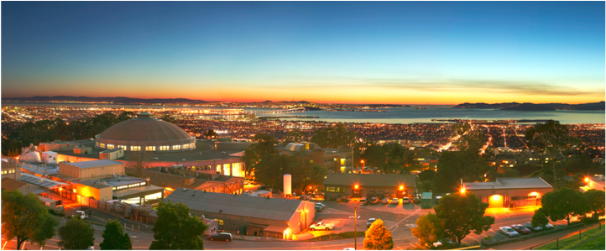
Modelica Training Workshop 5
Wangda Zuo, Michael Wetter
Simulation Research Group
Energy and Environmental Technologies Division
Lawrence Berkeley National Laboratory, USA
5/23/2012

Slide 2
Outline
Part 1: Discrete Events and Hybrid Systems
Part 2: Best Practice
2.2 Build Large System Models
2.3 Propagating Parameters and Media Packages
Workshop Website:
https://simulationresearch.lbl.gov/modelica/WorkShops/2012-05-07-lbnl

Slide 3
Exercise 1
model ifwhen
Real x;
Real y;
Real z;
equation
x = time;
when x >5 then
y = x + 1;
end when;
if x > 5 then
z = x + 1;
else
z = 0;
end if;
end ifwhen;

Slide 4
Part 2: Buildings Library
2. Best Practice (Continued)
2.2 Build Large System Models
2.3 Propagating Parameters and Media Packages
2.4 Thermal-fluid systems

Slide 5
2.2 Build Large System Models
How to solve not well-posted or over-specified problem when building a large complex system
Split the large system into small independent components
Test the small component with well controlled conditions.
Example:
Buildings.Examples.ChillerPlant.BaseClasses.Controls.Examples
KMinusU
Calculated with equations
RequestCounter
Uses algorithm
Commands->Simulate and plot

Slide 6
2.3 Propagating Parameters and Media Packages
Always define the value of common parameter at the top level of the model
Bad Practice
Good Practice

Slide 7
2.3 Propagating Parameters and Media Packages
Always define the value of common media package at the top level of the model
Top System Model
Sub-system Model that uses Sensor model
Sensor Model

Slide 8
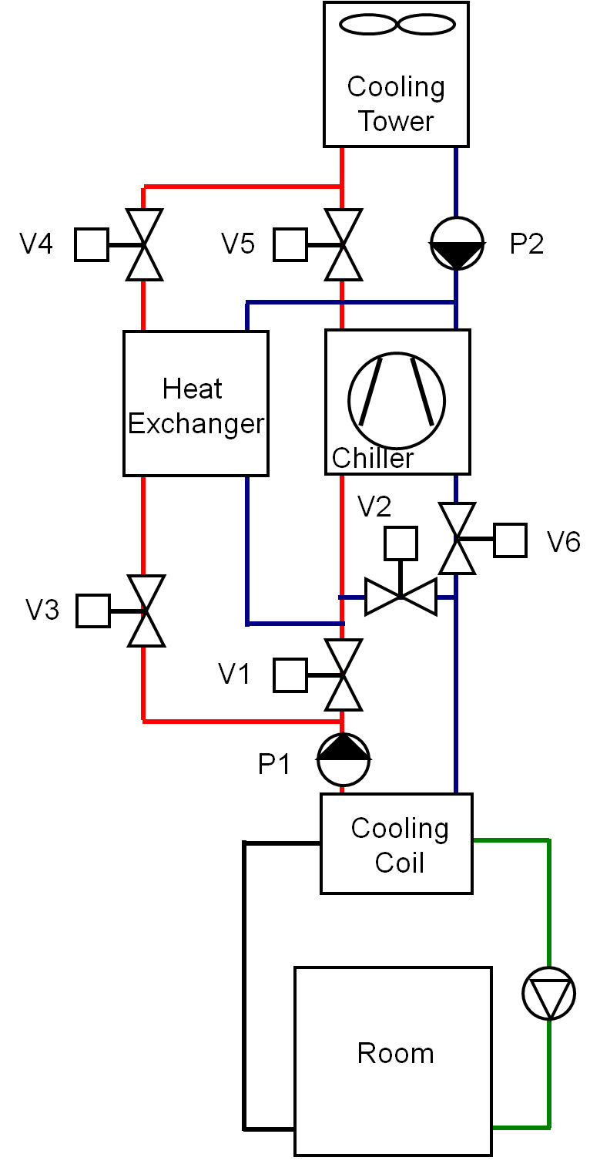
2.3 Propagating Parameters and Media Packages
Common parameters:
Nominal flow rate for air loop, chilled water loop and condenser water loop
Common media packages:
Air, Chilled water, Condenser water
Chiller plant with water-size economizer

Slide 9
2.3 Propagating Parameters and Media Packages
Find where these parameters and Medium packages are used:
Nominal Flow Conditions:
air loop: mAir_flow_nominal
chilled water loop: mCHW_flow_nominal
condenser water loop: mCW_flow_nominal
Common media packages:
Air: MediumAir
Chilled water: MediumCHW
Condenser water: MediumCW

Slide 10
2.3 Propagating Parameters and Media Packages
Find the path of propagating (e.g. Heat Exchanger):
1. System model
m1_flow_nominal=mCW_flow_nominal,
2. Buildings.Fluid.HeatExchangers.ConstantEffectiveness
m1_flow_nominal
3. Buildings.Fluid.HeatExchangers.BaseClasses.PartialEffectiveness
m1_flow_nominal
4. Buildings.Fluid.Interfaces.StaticFourPortHeatMassExchanger
5. Buildings.Fluid.Interfaces.PartialFourPortInterface

Slide 11
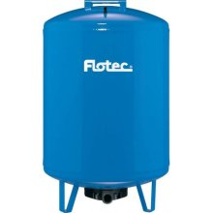
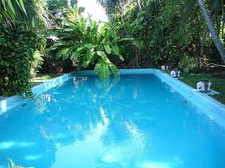
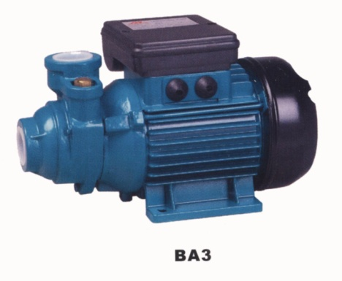
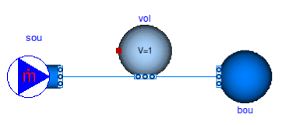
2.3 Thermal-fluid System
Source and Boundary Condition

Slide 12
2.3 Thermal-fluid System
Source and Boundary Condition
Step 1
Modelica.Fluid.Sources.MassFlowSource_T,
Buildings.Fluid.MixingVolumes.MixingVolume
Buildings.Fluid.Sources.FixedBoundary,
Step 2
Define the parameters
Step 3
Check the grammar
Compile and run simulation (need license)

Slide 13
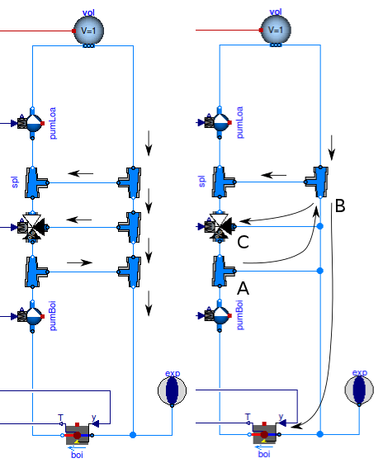
2.3 Thermal-fluid System
Model Fluid Junction
Correct
Wrong

Slide 14
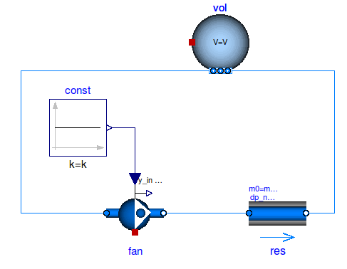
2.3 Thermal-fluid System
Thermal Expansion of Water

Slide 15
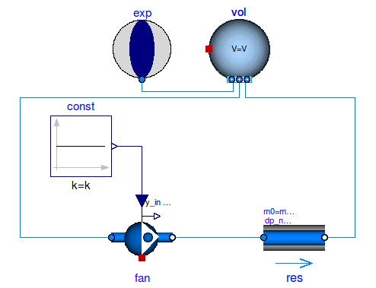
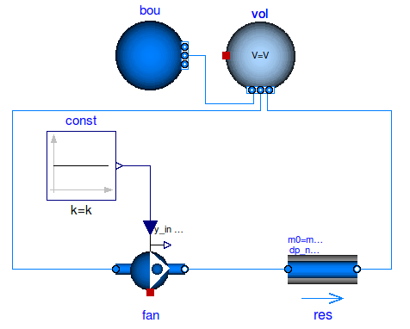
2.3 Thermal-fluid System
Thermal Expansion of Water
Expansion Vessel
Fixed Pressure BC

Slide 16
2.3 Thermal-fluid System
Nominal Values
Parameters for the nominal operating conditions.
Value set to component typically have if they are run at full load or design conditions

