Slide 1
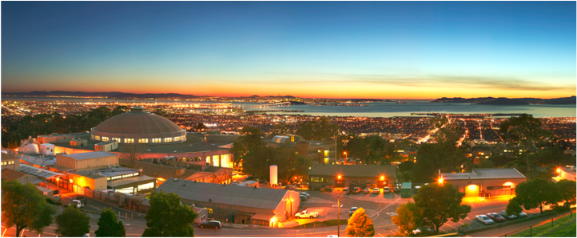
Modelica Training Workshop 4
Wangda Zuo, Michael Wetter
Simulation Research Group
Energy and Environmental Technologies Division
Lawrence Berkeley National Laboratory, USA
5/16/2012

Slide 2
Outline
Part 1: Equations, Algorithms and Functions
Part 2: Best Practice
2.1 Organization of packages (discussed in Workshop 3)
2.2 Build Large System Models
2.3 Propagating Parameters and Media Packages
Workshop Website:
https://simulationresearch.lbl.gov/modelica/WorkShops/2012-05-07-lbnl
Join the Google Group
https://groups.google.com/group/modelica-buildings

Slide 3
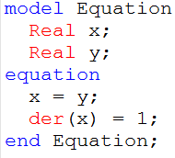
Exercise 1
Calculate the following equation system using equation
x = y
x’ = 1

Slide 4
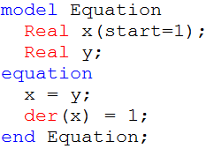
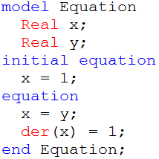
Exercise 1
Calculate the following equation system using equation
x = y
x’ = 1
x(0) = 1

Slide 5
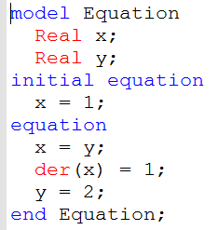
Exercise 1
Calculate the following equation system using equation
x = y
x’ = 1
x(0) = 1
y = 2
Error: model is not well-posted.

Slide 6
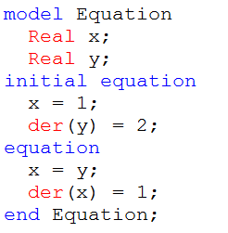
Exercise 1
Calculate the following equation system using equation
x = y
x’ = 1
x(0) = 1
y’(0) = 2
Error: Initial equations over-specified!

Slide 7
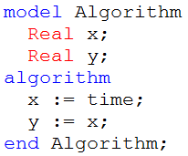
Exercise 2
Calculate the following equation system using algorithm
x = y
x’ = 1
Algorithm
Equation

Slide 8
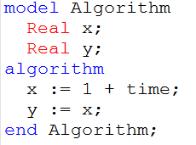
Exercise 2
Calculate the following equation system using equation
x = y
x’ = 1
x(0) = 1
Algorithm
Equation

Slide 9
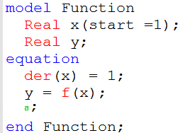
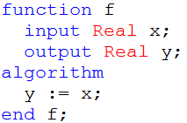
Exercise 3
Calculate the following equation system using model with functions
x’ = 1
y = f(x)
f(x) = x
x(0) = 1

Slide 10
Part 2: Buildings Library
2. Best Practice (Continued)
2.2 Build Large System Models
2.3 Propagating Parameters and Media Packages

Slide 11
2.2 Build Large System Models
How to solve not well-posted or over-specified problem when building a large complex system
Split the large system into small independent components
Test the small component with well controlled conditions.
Example:
Buildings.Examples.ChillerPlant.BaseClasses.Controls.Examples
KMinusU
Calculated with equations
RequestCounter
Uses algorithm
Commands->Simulate and plot

Slide 12
2.3 Propagating Parameters and Media Packages
Always define the value of common parameter at the top level of the model
Bad Practice
Good Practice

Slide 13
2.3 Propagating Parameters and Media Packages
Always define the value of common media package at the top level of the model
Top System Model
Sub-system Model that uses Sensor model
Sensor Model

Slide 14
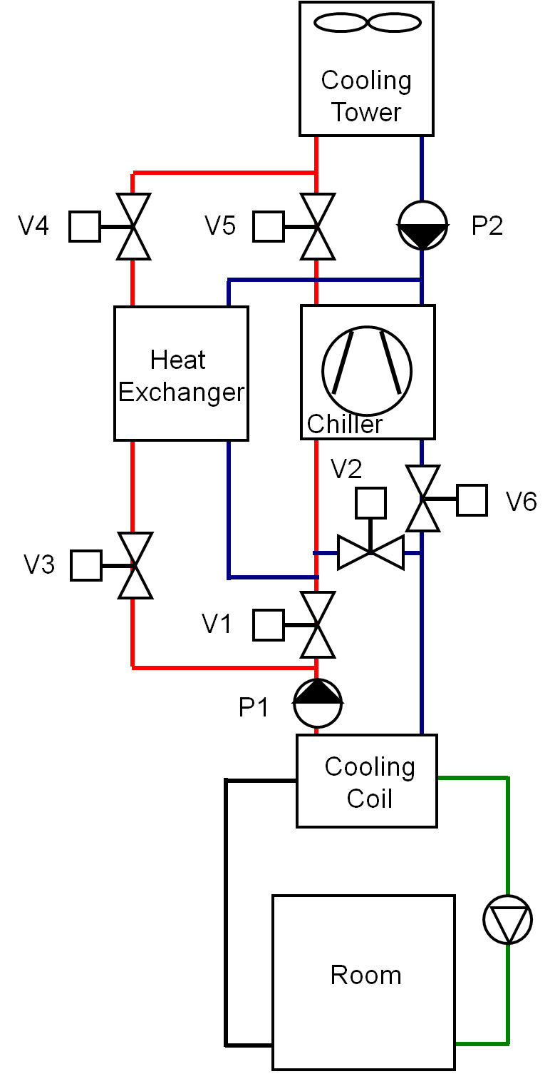
2.3 Propagating Parameters and Media Packages
Common parameters:
Nominal flow rate for air loop, chilled water loop and condenser water loop
Common media packages:
Air, Chilled water, Condenser water
Chiller plant with water-size economizer

Slide 15
2.3 Propagating Parameters and Media Packages
Find where these parameters and Medium packages are used:
Nominal Flow Conditions:
air loop: mAir_flow_nominal
chilled water loop: mCHW_flow_nominal
condenser water loop: mCW_flow_nominal
Common media packages:
Air: MediumAir
Chilled water: MediumCHW
Condenser water: MediumCW

Slide 16
2.3 Propagating Parameters and Media Packages
Find the path of propagating (e.g. Heat Exchanger):
1. System model
m1_flow_nominal=mCW_flow_nominal,
2. Buildings.Fluid.HeatExchangers.ConstantEffectiveness
m1_flow_nominal
3. Buildings.Fluid.HeatExchangers.BaseClasses.PartialEffectiveness
m1_flow_nominal
4. Buildings.Fluid.Interfaces.StaticFourPortHeatMassExchanger
5. Buildings.Fluid.Interfaces.PartialFourPortInterface

